Slide 1
Northwind
Case Study
Report
Izzah Luxfiati

Slide 2
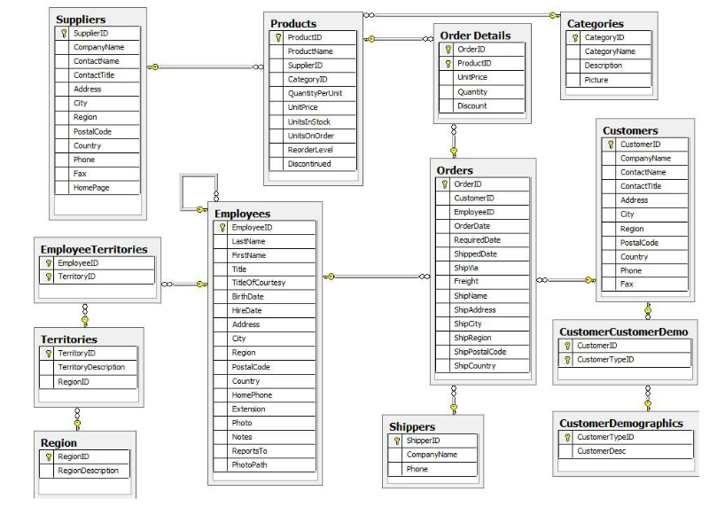
About Database
The Northwind database is a sample database used by Microsoft. The database contains the sales data for Northwind Traders, a fictitious specialty foods export import company.
NB : Rename Order Details table to OrderDetails to simplify the query process

Slide 3
Tools
Objective
Link Dashboard
ETL - Microsoft SQL Server Management Studio
Visualization - Looker Studio (Google Data Studio)
Flowchart - drawio (https://app.diagrams.net/)
Sales Analysis
Product Analysis
Customer Analysis
Dashboard Sales Analysis
https://datastudio.google.com/reporting/da670d46-4bf8-4b41-afad-c604666c938b
Dashboard Product Analysis
https://datastudio.google.com/reporting/1f91184b-c386-4ed3-b4ea-95906bda15d1
Dashboard Customer Analysis
https://lookerstudio.google.com/reporting/dde7cbf8-c38c-49b9-bf3b-070a12581f35

Slide 4
01.
Sales Analysis

Slide 5
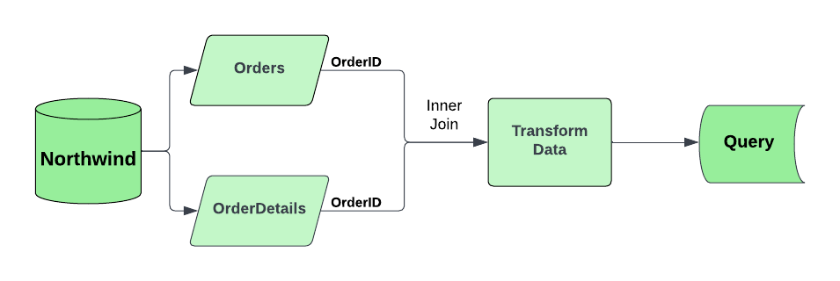
Study Case 1
For their annual sales review, the sales & marketing team wants to analyze sales trend in the period 4 July 1996 - 4 May 1998. They want make a query that consist of year, month, the number of customers who place orders, the number of products ordered, and total sales.
SELECT
YEAR(a.OrderDate) AS Year,
MONTH(a.OrderDate) AS Month,
COUNT(a.CustomerID) AS Customer_Amount,
SUM(b.Quantity) AS Order_Quantity,
ROUND(SUM((b.UnitPrice * b.Quantity)-((b.UnitPrice * b.Quantity) * b.Discount)), 2) AS Sales
FROM Orders AS a
INNER JOIN OrderDetails AS b
ON a.OrderID = b.OrderID
GROUP BY YEAR(a.OrderDate), MONTH(a.OrderDate)
ORDER BY Year, Month

Slide 6
Output
Table
Year | Month | Customer_Amount | Order_Quantity | Sales
1996 | 7 | 59 | 1462 | 27861,89
1996 | 8 | 69 | 1322 | 25485,28
1996 | 9 | 57 | 1124 | 26381,4
1996 | 10 | 73 | 1738 | 37515,72
1996 | 11 | 66 | 1735 | 45600,04
1996 | 12 | 81 | 2200 | 45239,63
1997 | 1 | 85 | 2401 | 61258,07
1997 | 2 | 79 | 2132 | 38483,64
1997 | 3 | 77 | 1770 | 38547,22
1997 | 4 | 81 | 1912 | 53032,95
1997 | 5 | 96 | 2164 | 53781,29
1997 | 6 | 76 | 1635 | 36362,8
1997 | 7 | 77 | 2054 | 51020,86
1997 | 8 | 84 | 1861 | 47287,67
1997 | 9 | 95 | 2343 | 55629,24
1997 | 10 | 106 | 2679 | 66749,23
1997 | 11 | 89 | 1856 | 43533,81
1997 | 12 | 114 | 2682 | 71398,43
1998 | 1 | 152 | 3466 | 94222,11
1998 | 2 | 122 | 3115 | 99415,29
1998 | 3 | 178 | 4065 | 104854,15
1998 | 4 | 180 | 4680 | 123798,68
1998 | 5 | 59 | 921 | 18333,63

Slide 7
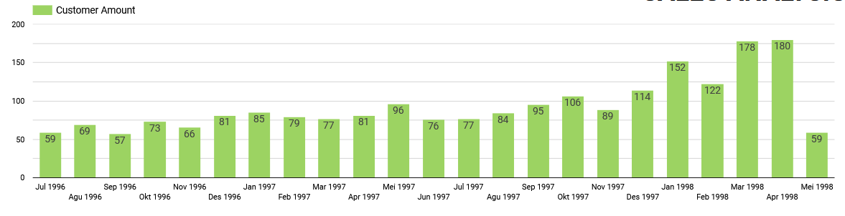
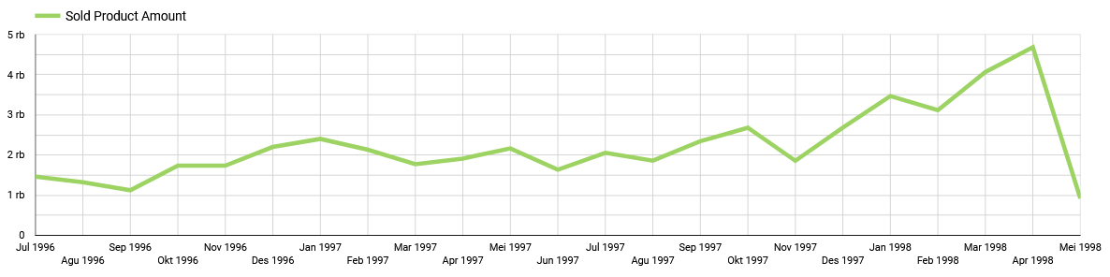

Slide 8
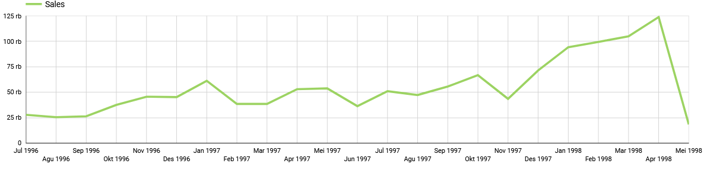
Analysis :
Significant increase in sales occurred in the period December 1997 - April 1998
This was due to an increase in the number of customers and sold products in that period
Recommendation :
The sales increase is a good thing for the marketing team and it will be good if marketing team analyze the reason behind those increase to catch another market chance & apply the best strategy in the next periode. The marketing team should maintain and increase sales targets for the next few months based on the latest sales trends.

Slide 9
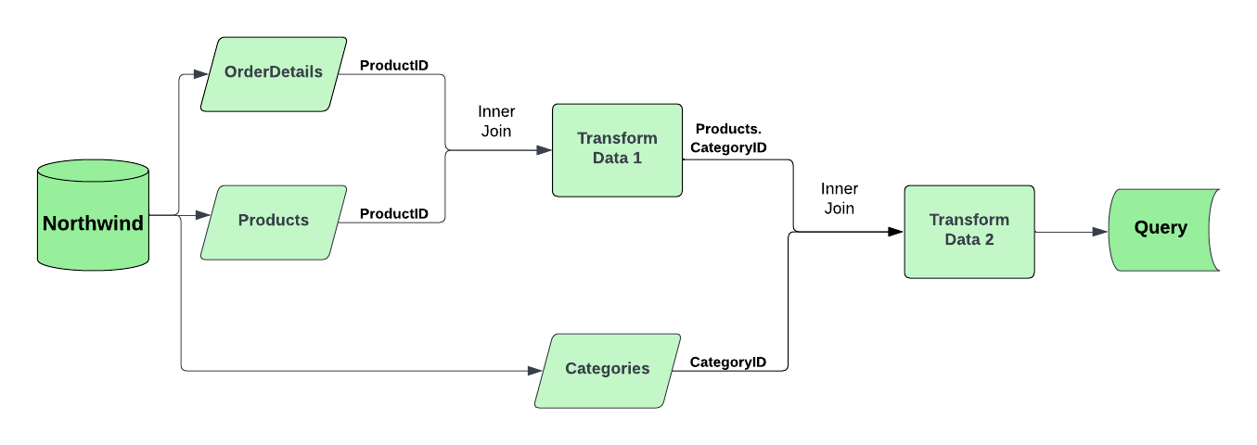
Study Case 2
The sales & marketing team also wants to analyze the total sales and order quantity in each product category in the period 4 July 1996 - 4 May 1998 to know in which product category, customers buy the most and buy the least product. They want make a query that consist of category name, sales, and product order quantity
SELECT
c.CategoryName,
ROUND(SUM(((a.UnitPrice * a.Quantity) - ((a.UnitPrice * a.Quantity) * a.Discount))),2) AS Sales,
SUM(a.Quantity) AS Order_Quantity
FROM OrderDetails AS a
iNNER JOIN Products AS b
ON a.ProductID = b.ProductID
iNNER JOIN Categories AS c
ON b.CategoryID = c.CategoryID
GROUP BY CategoryName
ORDER BY Sales DESC

Slide 10
Output Table
CategoryName | Sales | Order_Quantity
Beverages | 267868,18 | 9532
Dairy Products | 234507,29 | 9149
Confections | 167357,22 | 7906
Meat/Poultry | 163022,36 | 4199
Seafood | 131261,74 | 7681
Condiments | 106047,08 | 5298
Produce | 99984,58 | 2990
Grains/Cereals | 95744,59 | 4562

Slide 11
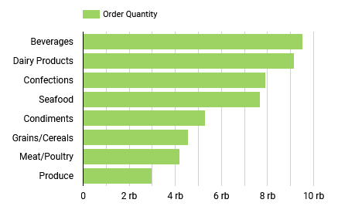
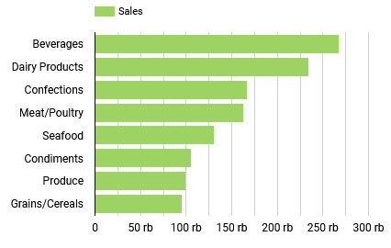
Analysis :
The most purchased product and has the highest number of sales is beverages product category. The second and the third are daily products & confections product categories.
The least purchased product is produce product category. The lowest number of sales is in grains/cereals product categories.
Recommendation :
For products that have a low order quantity, the marketing team should carry out promotions to increase the attractiveness of buyers for these products.
if in the next period, the marketing team focuses more on increasing sales revenue, then optimizing the promotion and sales of meal/poultry products is a good opportunity. Because meal/poultry products is the second product that least to be purchased but the total sales is quite high (unit price is high).

Slide 12
Study Case 3
In the next month, Northwind company celebrates the company's 50th anniversary, company management agreed to give a 15% special discount for the top 10 products that have the most sales. The discount is given for a week from the company's anniversary day. The sales & marketing team will make a new list of unit price for top 10 product that have the most sales, they want make a query that consist of product name, product category, sales, rank, unit price, and unit price after discount
SELECT
TOP 10 b.ProductName AS Product_Name,
c.CategoryName AS Product_Category,
ROUND(SUM(((a.UnitPrice * a.Quantity)-((a.UnitPrice * a.Quantity) * a.Discount))),2) AS Sales,
ROW_NUMBER() OVER (ORDER BY ROUND(SUM(((a.UnitPrice * a.Quantity) - ((a.UnitPrice * a.Quantity) * a.Discount))), 2) DESC) AS Rank,
b.UnitPrice AS Unit_Price,
CAST((b.UnitPrice - (b.UnitPrice*0.15)) AS DECIMAL(10,2)) AS Discount_Price
FROM OrderDetails AS a
INNER JOIN Products AS b
ON a.ProductID = b.ProductID
INNER JOIN Categories AS c
ON b.CategoryID = c.CategoryID
GROUP BY b.ProductName, c.CategoryName, b.UnitPrice

Slide 13
Output Table
Product_Name | Product_Category | Sales | Rank | Unit_Price | Discount_Price
Côte de Blaye | Beverages | 141396,74 | 1 | 263,5 | 223.98
Thüringer Rostbratwurst | Meat/Poultry | 80368,67 | 2 | 123,79 | 105.22
Raclette Courdavault | Dairy Products | 71155,7 | 3 | 55 | 46.75
Tarte au sucre | Confections | 47234,97 | 4 | 49,3 | 41.91
Camembert Pierrot | Dairy Products | 46825,48 | 5 | 34 | 28.90
Gnocchi di nonna Alice | Grains/Cereals | 42593,06 | 6 | 38 | 32.30
Manjimup Dried Apples | Produce | 41819,65 | 7 | 53 | 45.05
Alice Mutton | Meat/Poultry | 32698,38 | 8 | 39 | 33.15
Carnarvon Tigers | Seafood | 29171,88 | 9 | 62,5 | 53.13
Rössle Sauerkraut | Produce | 25696,64 | 10 | 45,6 | 38.76

Slide 14
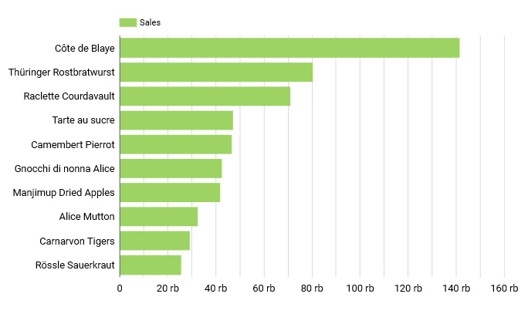
Analysis :
Côte de Blaye products are one of the products that have the most sales compared to other products. Côte de Blaye products are the only products that have sales value above 100,000, while the other top 9 products have sales under 100,000.
Recommendation :
To attract the attention of buyers with discounts on these top 10 products and to maintain sales revenue in the next month, the marketing team should carry out discount promotions not only for loyal customers, but also need to make offers to potential new customers. This discount is not only used to maintain customer loyalty but also this will be good opportunity to attract many potential new customers too.

Slide 15
Study Case 4
The sales & marketing team want to analyze sales based on country. They want to see The top 3 countries that have the most sales in beverages, dairy product, and confections product category. They want make a query that consist of product category, country, sales and rank.
WITH table1 AS(
SELECT
d.CategoryName AS Product_Category, a.ShipCountry AS Country,
ROUND(SUM(((b.UnitPrice * b.Quantity) - ((b.UnitPrice * b.Quantity) *b.Discount))), 2) AS Sales,
ROW_NUMBER() OVER (PARTITION BY d.CategoryName
ORDER BY ROUND(SUM(((b.UnitPrice * b.Quantity) - ((b.UnitPrice * b.Quantity) * b.Discount))), 2) DESC) AS Rank
FROM Orders AS a
INNER JOIN OrderDetails AS b
ON a.OrderID = b.OrderID
INNER JOIN Products AS c
ON b.ProductID = c.ProductID
INNER JOIN Categories AS d
ON c.CategoryID = d.CategoryID
WHERE d.CategoryName IN ('Beverages','Dairy Products', 'Confections')
GROUP BY d.CategoryName, a.ShipCountry)
SELECT *
FROM table1
WHERE Rank <= 3

Slide 16
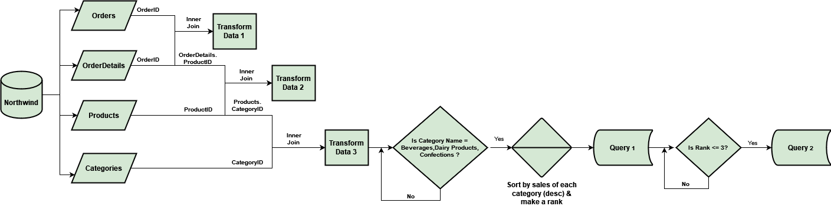

Slide 17
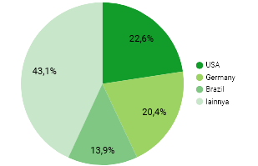
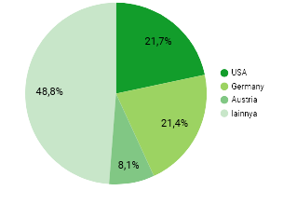
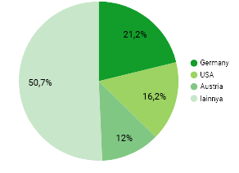
Output Table
Top 3 Countries
In Beverages Sales
Top 3 Countries
In Confections Sales
Product_Category | Country | Sales | Rank
Beverages | USA | 60520,97 | 1
Beverages | Germany | 54634,12 | 2
Beverages | Brazil | 37193,44 | 3
Confections | USA | 36314,93 | 1
Confections | Germany | 35878,6 | 2
Confections | Austria | 13534,41 | 3
Dairy Products | Germany | 49640,95 | 1
Dairy Products | USA | 37902,05 | 2
Dairy Products | Austria | 28106,74 | 3
Top 3 Countries
In Dairy Product Sales
Analysis :
USA and Germany are the 2 countries that have the most sales for these three product categories.
Austria is the third country with the most sales for the confections & dairy products category

Slide 18
02.
Product Analysis

Slide 19
Study Case 1
Product development team decided not to continue selling certain products, they wanted to make a list of discontinued products that still have remaining stock. They will give 30% discount for that product. They need a query that consist of product name, product category, amount of remaining stock, unit price, and discount price.
SELECT
a.ProductName AS Product_Name,
b.CategoryName AS Product_Category,
SUM(a.UnitsInStock) AS Stock,
a.UnitPrice AS Unit_Price,
CAST((a.UnitPrice - (a.UnitPrice * 0.3)) AS DECIMAL(10,2)) AS Discount_Price
FROM Products AS a
INNER JOIN Categories AS b
ON a.CategoryID = b.CategoryID
WHERE a.Discontinued = 1
GROUP BY a.ProductName, b.CategoryName, a.UnitPrice
HAVING SUM(a.UnitsInStock) > 0

Slide 20
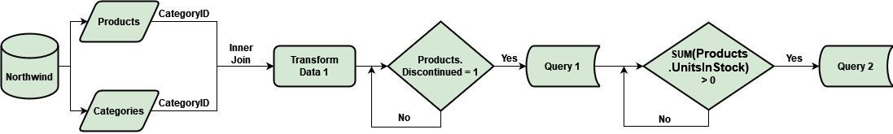

Slide 21
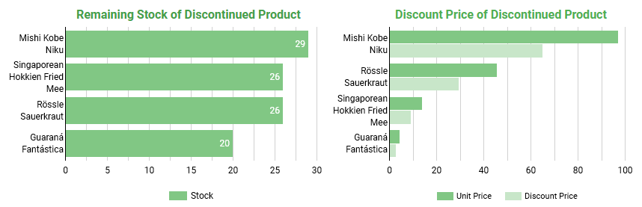
Output Table
Product_Name | Product_Category | Stock | Unit_Price | Discount_Price
Guaraná Fantástica | Beverages | 20 | 4,5 | 3.15
Mishi Kobe Niku | Meat/Poultry | 29 | 97 | 67.90
Rössle Sauerkraut | Produce | 26 | 45,6 | 31.92
Singaporean Hokkien Fried Mee | Grains/Cereals | 26 | 14 | 9.80
There are 4 discontinued product with remaining stock. The product will be discounted by 30% from the unit price

Slide 22
Study Case 2
Product development team wants to know how each product category performs according to their prices range (below 25, 25-50, over 50). They want to make a query that consists of product category, price ranges, order quantity, and sales.
SELECT
b.CategoryName AS Product_Category,
CASE WHEN a.UnitPrice < 25 THEN '1. Below $20'
WHEN a.UnitPrice BETWEEN 25 AND 50 THEN '2. $20 - $50'
WHEN a.UnitPrice > 50 THEN '3. Over $50'
END AS Price_Range,
SUM(c.Quantity) AS Order_Quantity,
ROUND(SUM(((c.UnitPrice * c.Quantity) - ((c.UnitPrice * c.Quantity) * c.Discount))),2) AS Sales
FROM Products AS a
iNNER JOIN Categories AS b
ON a.CategoryID = b.CategoryID
INNER JOIN OrderDetails AS c
ON a.ProductID = c.ProductID
GROUP BY b.CategoryName,
CASE WHEN a.UnitPrice < 25 THEN '1. Below $20'
WHEN a.UnitPrice BETWEEN 25 AND 50 THEN '2. $20 - $50'
WHEN a.UnitPrice > 50 THEN '3. Over $50'
END
ORDER BY Product_Category,, Price_Range

Slide 23
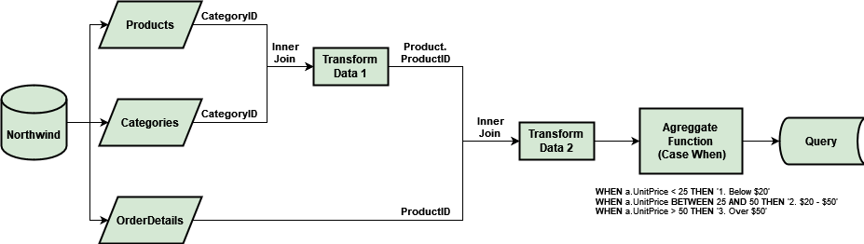

Slide 24
Output
Table
Product_Category | Price_Range | Order_Quantity | Sales
Beverages | 1. Below $20 | 8329 | 102944,75
Beverages | 2. $20 - $50 | 580 | 23526,7
Beverages | 3. Over $50 | 623 | 141396,74
Condiments | 1. Below $20 | 3577 | 55084,39
Condiments | 2. $20 - $50 | 1721 | 50962,69
Confections | 1. Below $20 | 5392 | 62609,88
Confections | 2. $20 - $50 | 2201 | 82183,99
Confections | 3. Over $50 | 313 | 22563,36
Dairy Products | 1. Below $20 | 3915 | 49021,8
Dairy Products | 2. $20 - $50 | 3738 | 114329,79
Dairy Products | 3. Over $50 | 1496 | 71155,7
Grains/Cereals | 1. Below $20 | 2559 | 31193,56
Grains/Cereals | 2. $20 - $50 | 2003 | 64551,03
Meat/Poultry | 1. Below $20 | 1658 | 22154,64
Meat/Poultry | 2. $20 - $50 | 1700 | 53272,55
Meat/Poultry | 3. Over $50 | 841 | 87595,17
Produce | 1. Below $20 | 701 | 10423,99
Produce | 2. $20 - $50 | 1403 | 47740,94
Produce | 3. Over $50 | 886 | 41819,65
Seafood | 1. Below $20 | 5663 | 65109,93
Seafood | 2. $20 - $50 | 1479 | 36979,94
Seafood | 3. Over $50 | 539 | 29171,88

Slide 25
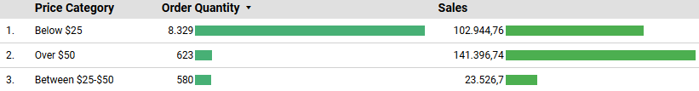
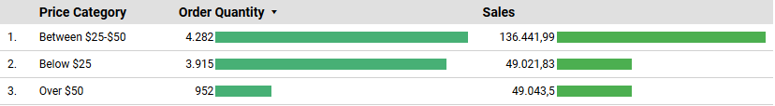
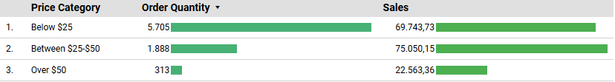
Beverages
Dairy Products
Confections

Slide 26
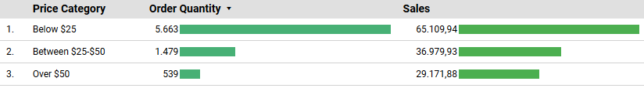

Seafood
Condiments
Grains / Cereals

Slide 27
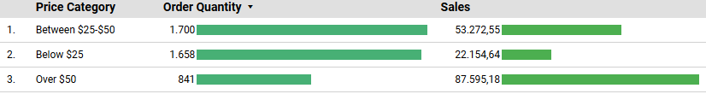
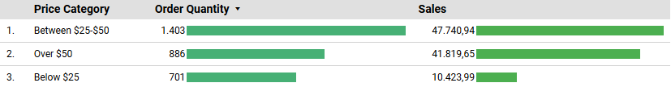
Meat / Poultry
Produce
Analysis :
Beverages, confections, seafood, condiments, and grains/cereals with a price range below $25 are product categories that have the most order quantity among the other price ranges with the same product category.
Dairy products, meat/poultry, and produce with a price range between $25-$50 are product categories that have the highest number of orders among the other price ranges with the same product category.
Beverage & meat poultry with price range over $50 are the product categories that have the most sales among the other price ranges with the same product category.
Dairy products, confections, grains/cereals, and produce with price range between $25-$50 are the product categories that have the most sales among the other price ranges with the same product category.
Seafood & condiments with price range over $50 are the product categories that have the most sales among the other price ranges with the same product category.

Slide 28
Study Case 3
Product development team created a new packaging design for seafood product category with the 3 lowest sales, The product must not include in discontinued product list. This innovation aims to attract customer interest and there is an additional cost of 1% from the previous product unit price. They want make a query that consist of product name, sales, rank, unit price, new price.
WITH table1 AS (
SELECT
c.ProductName AS Product_Name,
ROUND(SUM(((b.UnitPrice * b.Quantity) - ((b.UnitPrice * b.Quantity) *b.Discount))), 2) AS Sales,
ROW_NUMBER() OVER (PARTITION BY d.CategoryName
ORDER BY ROUND(SUM(((b.UnitPrice * b.Quantity) - ((b.UnitPrice * b.Quantity) * b.Discount))), 2) ASC) AS Rank,
c.UnitPrice AS Unit_Price,
CAST((c.UnitPrice + (c.UnitPrice * 0.01)) AS DECIMAL(10,2)) AS New_Price
FROM Orders AS a
INNER JOIN OrderDetails AS b
ON a.OrderID = b.OrderID
INNER JOIN Products AS c
ON b.ProductID = c.ProductID
INNER JOIN Categories AS d
ON c.CategoryID = d.CategoryID
WHERE d.CategoryName = 'Seafood' AND c.Discontinued = 0
GROUP BY c.ProductName, d.CategoryName, c.UnitPrice )
SELECT *
FROM table1
WHERE Rank <= 3

Slide 29
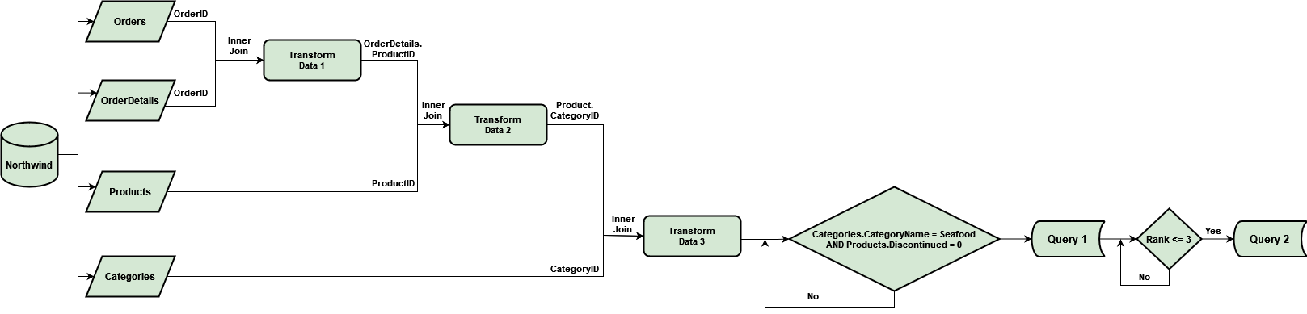

Slide 30
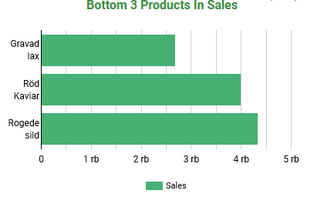
Output Table
Product_Name | Sales | Rank | Unit_Price | New_Price
Gravad lax | 2688,4 | 1 | 26 | 26.26
Röd Kaviar | 3997,2 | 2 | 15 | 15.15
Rogede sild | 4338,18 | 3 | 9,5 | 9.60
Analysis :
Gravad lax, rod kaviae, rogede slid are seafood product that include in bottom 3 seafood products in sales, with sales under 4350
Gravad tax is the lowest product in sales in seafood product category.
Recommendation :
after carrying out packaging design innovations for the 3 seafood products with the lowest sales, in order to attract customer interest, further advertising should be carried out

Slide 31
02.
Customer Analysis

Slide 32
Study Case 1
Customer relations team wants to group customers into several segments based on the frequency of purchases . There are 3 categories customer :
Heavy Users
Customers who purchase the product most frequently. These tend to be the most avid and
engaged customers. (order frequency > 50 )
Average Users
Customers that semi-regularly purchase our product, but not frequently.
(20 <= order frequency <= 50)
Light Users
Customers that use or purchase much less in proportion than to the other customers.
(order frequency < 20)
They want to make 2 queries :
Query 1
They want to make a list of customers who include into that category. This query consist of name of customer (company name), customer category, order frequency, order quantity.
Query 2
They want to know the order frequency, order quantity, & customer amount of each category.

Slide 33
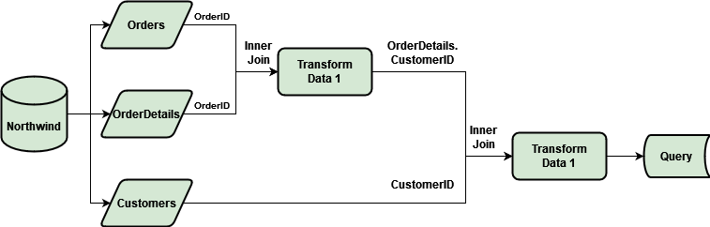
Query 1
SELECT
c.CompanyName AS Company_Name,
CASE WHEN Count(a.OrderID) > 50 THEN 'Heavy Users'
WHEN Count(a.OrderID) BETWEEN 20 AND 50 THEN 'Average Users'
WHEN Count(a.OrderID) < 20 THEN 'Light Users'
END AS Customer_Category,
COUNT(a.OrderID) AS Order_Frequency,
SUM(b.Quantity) AS Order_Quantity
FROM Orders AS a
INNER JOIN OrderDetails AS b
ON a.OrderID = b.OrderID
INNER JOIN Customers AS c
ON a.CustomerID = c.CustomerID
GROUP BY c.CompanyName
ORDER BY Customer_Category, c.CompanyName

Slide 34
Output Table
(Heavy Users)
Company_Name | Customer_Category | Order_Frequency | Order_Quantity
Berglunds snabbköp | Heavy Users | 52 | 1001
Ernst Handel | Heavy Users | 102 | 4543
Hungry Owl All-Night Grocers | Heavy Users | 55 | 1684
QUICK-Stop | Heavy Users | 86 | 3961
Rattlesnake Canyon Grocery | Heavy Users | 71 | 1383
Save-a-lot Markets | Heavy Users | 116 | 4958

Slide 35
Output Table (Average Users)
Company_Name | Customer_Category | Order_Frequency | Order_Quantity
Around the Horn | Average Users | 30 | 650
Blondesddsl père et fils | Average Users | 26 | 666
Bon app' | Average Users | 44 | 980
Bottom-Dollar Markets | Average Users | 35 | 956
B's Beverages | Average Users | 22 | 293
Chop-suey Chinese | Average Users | 22 | 465
Die Wandernde Kuh | Average Users | 26 | 492
Eastern Connection | Average Users | 21 | 569
Folk och fä HB | Average Users | 45 | 1234
Frankenversand | Average Users | 48 | 1525
Furia Bacalhau e Frutos do Mar | Average Users | 20 | 349
Godos Cocina Típica | Average Users | 26 | 395
Great Lakes Food Market | Average Users | 22 | 345
Hanari Carnes | Average Users | 32 | 839
HILARION-Abastos | Average Users | 45 | 1096
Island Trading | Average Users | 23 | 295
Königlich Essen | Average Users | 39 | 903
La maison d'Asie | Average Users | 31 | 442
Lehmanns Marktstand | Average Users | 39 | 794
LILA-Supermercado | Average Users | 34 | 836

Slide 36
Output Table (Average Users)
Company_Name | Customer_Category | Order_Frequency | Order_Quantity
LINO-Delicateses | Average Users | 35 | 970
Magazzini Alimentari Riuniti | Average Users | 21 | 433
Mère Paillarde | Average Users | 32 | 966
Old World Delicatessen | Average Users | 24 | 603
Ottilies Käseladen | Average Users | 29 | 639
Piccolo und mehr | Average Users | 23 | 624
Que Delícia | Average Users | 24 | 394
Queen Cozinha | Average Users | 40 | 1031
Reggiani Caseifici | Average Users | 22 | 335
Ricardo Adocicados | Average Users | 27 | 660
Richter Supermarkt | Average Users | 30 | 810
Seven Seas Imports | Average Users | 26 | 818
Split Rail Beer & Ale | Average Users | 20 | 327
Suprêmes délices | Average Users | 39 | 1072
Tortuga Restaurante | Average Users | 29 | 384
Vaffeljernet | Average Users | 31 | 792
Victuailles en stock | Average Users | 25 | 434
Wartian Herkku | Average Users | 37 | 737
White Clover Markets | Average Users | 40 | 1063

Slide 37
Output Table (Light Users)
Company_Name | Customer_Category | Order_Frequency | Order_Quantity
Alfreds Futterkiste | Light Users | 12 | 174
Ana Trujillo Emparedados y helados | Light Users | 10 | 63
Antonio Moreno Taquería | Light Users | 17 | 359
Blauer See Delikatessen | Light Users | 14 | 140
Bólido Comidas preparadas | Light Users | 6 | 190
Cactus Comidas para llevar | Light Users | 11 | 115
Centro comercial Moctezuma | Light Users | 2 | 11
Comércio Mineiro | Light Users | 10 | 133
Consolidated Holdings | Light Users | 7 | 87
Drachenblut Delikatessen | Light Users | 10 | 160
Du monde entier | Light Users | 9 | 80
Familia Arquibaldo | Light Users | 19 | 357
Folies gourmandes | Light Users | 16 | 354
France restauration | Light Users | 6 | 69
Franchi S.p.A. | Light Users | 10 | 54
Galería del gastrónomo | Light Users | 8 | 42
Gourmet Lanchonetes | Light Users | 19 | 315
GROSELLA-Restaurante | Light Users | 4 | 34
Hungry Coyote Import Store | Light Users | 9 | 122

Slide 38
Output Table (Light Users)
Company_Name | Customer_Category | Order_Frequency | Order_Quantity
La corne d'abondance | Light Users | 11 | 83
Laughing Bacchus Wine Cellars | Light Users | 8 | 62
Lazy K Kountry Store | Light Users | 2 | 20
Let's Stop N Shop | Light Users | 10 | 181
Lonesome Pine Restaurant | Light Users | 14 | 134
Maison Dewey | Light Users | 17 | 320
Morgenstern Gesundkost | Light Users | 11 | 172
North/South | Light Users | 6 | 30
Océano Atlántico Ltda. | Light Users | 11 | 132
Pericles Comidas clásicas | Light Users | 14 | 208
Princesa Isabel Vinhos | Light Users | 10 | 184
Rancho grande | Light Users | 12 | 92
Romero y tomillo | Light Users | 14 | 91
Santé Gourmet | Light Users | 16 | 161
Simons bistro | Light Users | 15 | 378
Spécialités du monde | Light Users | 6 | 48
The Big Cheese | Light Users | 7 | 46
The Cracker Box | Light Users | 8 | 59
Toms Spezialitäten | Light Users | 14 | 253

Slide 39
Output Table (Light Users)
Company_Name | Customer_Category | Order_Frequency | Order_Quantity
Tradição Hipermercados | Light Users | 13 | 251
Trail's Head Gourmet Provisioners | Light Users | 9 | 89
Vins et alcools Chevalier | Light Users | 10 | 98
Wellington Importadora | Light Users | 19 | 267
Wilman Kala | Light Users | 17 | 148
Wolski Zajazd | Light Users | 16 | 205

Slide 40
Query 2
WITH table1 AS(
SELECT
c.CompanyName AS Company_Name,
CASE WHEN Count(a.OrderID) > 50 THEN 'Heavy Users'
WHEN Count(a.OrderID) BETWEEN 20 AND 50 THEN 'Average Users'
WHEN Count(a.OrderID) < 20 THEN 'Light Users'
END AS Customer_Category,
COUNT(a.OrderID) AS Order_Frequency,
SUM(b.Quantity) AS Order_Quantity,
CAST(SUM((b.Quantity * b.UnitPrice) - ((b.Quantity * b.UnitPrice) * b.Discount)) AS DECIMAL(10,2)) AS Purchase_Amount
FROM Orders AS a
INNER JOIN OrderDetails AS b
ON a.OrderID = b.OrderID
INNER JOIN Customers AS c
ON a.CustomerID = c.CustomerID
GROUP BY c.CompanyName)
SELECT
Customer_Category,
COUNT(Company_Name) AS Customer_Amount,
SUM(Order_Frequency) AS Order_Frequency,
SUM(Order_Quantity) AS Order_Quantity
FROM table1
GROUP BY Customer_Category
ORDER BY Order_Frequency DESC

Slide 41
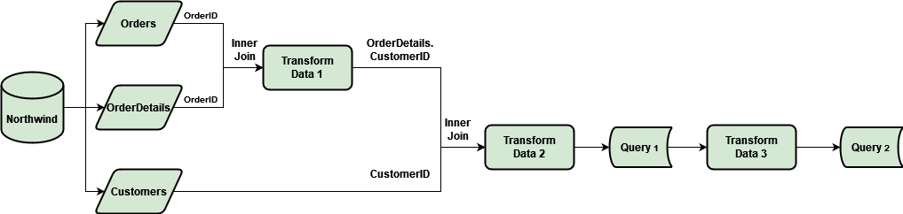
Output Table
Customer_Category | Customer_Amount | Order_Frequency | Order_Quantity
Average Users | 39 | 1184 | 27216
Light Users | 44 | 489 | 6571
Heavy Users | 6 | 482 | 17530

Slide 42
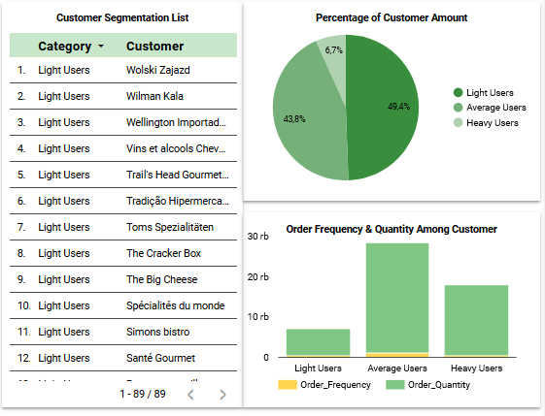
Analysis :
Customers who are classified as light users have the highest customer amount (49,4%). Light users have the lowest order frequency and order quantity.
While customers who are classified as heavy users have the least customer amount (6.7%).
Average users have the highest order frequency and order quantity.
Recommendation :
Customer relations team should target the right method to retain the customer loyalty in heavy & average users, such as using reward program. Marketing team should use the right marketing strategies for each category, and turn light user into average and heavy users.

Slide 43
Study Case 2
The customer relations team wants to know the total discount given to the customer and wants to analyze how the discount is related to the number of purchases. They want to make a query that consist of customer name (company name), total discount, purchase amount, rank based on total discount.
SELECT
b.CompanyName AS Company_Name,
CAST(SUM(c.Discount) AS DECIMAL(10,2)) AS Total_Discount,
CAST(SUM((c.Quantity * c.UnitPrice) - ((c.Quantity * c.UnitPrice) * c.Discount)) AS DECIMAL(10,2)) AS Purchase
FROM Orders AS a
INNER JOIN Customers AS b
ON a.CustomerID = b.CustomerID
INNER JOIN OrderDetails AS c
ON a.OrderID = c.OrderID
GROUP BY b.CompanyName
ORDER BY Total_Discount

Slide 44
Output Table
Company_Name | Total_Discount | Purchase
Save-a-lot Markets | 9.60 | 104361.95
Ernst Handel | 6.95 | 104874.98
Hungry Owl All-Night Grocers | 6.25 | 49979.90
QUICK-Stop | 5.95 | 110277.30
La maison d'Asie | 3.90 | 9328.20
Folk och fä HB | 3.85 | 29567.56
Lehmanns Marktstand | 3.75 | 19261.41
Queen Cozinha | 3.60 | 25717.50
LILA-Supermercado | 3.30 | 16076.60
Bon app' | 3.20 | 21963.25
Frankenversand | 3.15 | 26656.56
LINO-Delicateses | 3.10 | 16476.56
Berglunds snabbköp | 3.00 | 24927.58
Bottom-Dollar Markets | 2.95 | 20801.60
White Clover Markets | 2.75 | 27363.60
Rattlesnake Canyon Grocery | 2.49 | 51097.80
Victuailles en stock | 2.30 | 9182.43
Die Wandernde Kuh | 2.30 | 9588.43
Hanari Carnes | 2.15 | 32841.37
Simons bistro | 2.10 | 16817.10
Company_Name | Total_Discount | Purchase
Wartian Herkku | 2.00 | 15648.70
Furia Bacalhau e Frutos do Mar | 1.95 | 6427.42
Seven Seas Imports | 1.90 | 16215.33
Mère Paillarde | 1.85 | 28872.19
Split Rail Beer & Ale | 1.85 | 11441.63
Reggiani Caseifici | 1.80 | 7048.24
Ottilies Käseladen | 1.70 | 12496.20
Piccolo und mehr | 1.65 | 23128.86
Old World Delicatessen | 1.60 | 15177.46
Königlich Essen | 1.55 | 30908.38
Great Lakes Food Market | 1.55 | 18507.45
Wellington Importadora | 1.55 | 6068.20
HILARION-Abastos | 1.50 | 22768.76
Que Delícia | 1.45 | 6664.81
Chop-suey Chinese | 1.30 | 12348.88
Gourmet Lanchonetes | 1.30 | 8414.14
Ricardo Adocicados | 1.30 | 12450.80
Richter Supermarkt | 1.25 | 19343.78
Toms Spezialitäten | 1.25 | 4778.14
Familia Arquibaldo | 1.20 | 4107.55

Slide 45
Output Table
Company_Name | Total_Discount | Purchase
Suprêmes délices | 1.15 | 24088.78
Let's Stop N Shop | 1.10 | 3076.47
Magazzini Alimentari Riuniti | 1.05 | 7176.22
Godos Cocina Típica | 1.05 | 11446.36
Alfreds Futterkiste | 1.05 | 4273.00
Antonio Moreno Taquería | 1.00 | 7023.98
Maison Dewey | 1.00 | 9736.07
Vaffeljernet | 1.00 | 15843.92
Tradição Hipermercados | 0.95 | 6850.66
Princesa Isabel Vinhos | 0.90 | 5044.94
Blondesddsl père et fils | 0.75 | 18534.08
Around the Horn | 0.70 | 13390.65
Bólido Comidas preparadas | 0.70 | 4232.85
Eastern Connection | 0.50 | 14761.04
North/South | 0.00 | 649.00
Lonesome Pine Restaurant | 0.00 | 4258.60
Lazy K Kountry Store | 0.00 | 357.00
Wilman Kala | 0.00 | 3161.35
Ana Trujillo Emparedados y helados | 0.00 | 1402.95
Du monde entier | 0.00 | 1615.90
Company_Name | Total_Discount | Purchase
France restauration | 0.00 | 3172.16
Vins et alcools Chevalier | 0.00 | 1480.00
Galería del gastrónomo | 0.00 | 836.70
Laughing Bacchus Wine Cellars | 0.00 | 522.50
Romero y tomillo | 0.00 | 1467.29
Centro comercial Moctezuma | 0.00 | 100.80
Comércio Mineiro | 0.00 | 3810.75
Wolski Zajazd | 0.00 | 3531.95
Island Trading | 0.00 | 6146.30
Océano Atlántico Ltda. | 0.00 | 3460.20
Blauer See Delikatessen | 0.00 | 3239.80
Folies gourmandes | 0.00 | 11666.90
Hungry Coyote Import Store | 0.00 | 3063.20
Morgenstern Gesundkost | 0.00 | 5042.20
Franchi S.p.A. | 0.00 | 1545.70
Santé Gourmet | 0.00 | 5735.15
Pericles Comidas clásicas | 0.00 | 4242.20
Rancho grande | 0.00 | 2844.10
Cactus Comidas para llevar | 0.00 | 1814.80
La corne d'abondance | 0.00 | 1992.05

Slide 46
Output
Table
Company_Name | Total_Discount | Purchase
Spécialités du monde | 0.00 | 2423.35
GROSELLA-Restaurante | 0.00 | 1488.70
Drachenblut Delikatessen | 0.00 | 3763.21
B's Beverages | 0.00 | 6089.90
Tortuga Restaurante | 0.00 | 10812.15
The Big Cheese | 0.00 | 3361.00
Consolidated Holdings | 0.00 | 1719.10
The Cracker Box | 0.00 | 1947.24
Trail's Head Gourmet Provisioners | 0.00 | 1571.20

Slide 47
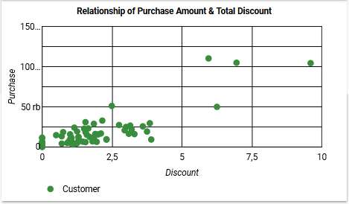
Analysis :
From that scatter plot, there is positive correlation between discount and total purchase. It means that the more the number of discounts given, the number of purchases will also increase
Recommendation :
Customer relations team can use discount stimuli to increase total sales and maintain customer loyalty

Slide 48
Study Case 3
The customer relations team wants to know the top 5 customers who have the highest purchase value for each product category. They want to make a query that consist of product category, name customer (company name), purchase amount, rank.
WITH table1 AS (
SELECT
e.CategoryName AS Product_Category,
b.CompanyName AS Company_Name,
CAST(SUM((c.Quantity * c.UnitPrice) - ((c.Quantity * c.UnitPrice) * c.Discount)) AS DECIMAL(10,2)) AS Purchase,
ROW_NUMBER() OVER (PARTITION BY e.CategoryName ORDER BY
SUM((c.Quantity * c.UnitPrice) - ((c.Quantity * c.UnitPrice) * c.Discount)) DESC) AS Rank
FROM Orders AS a
INNER JOIN Customers AS b
ON a.CustomerID = b.CustomerID
INNER JOIN OrderDetails AS c
ON a.OrderID = c.OrderID
INNER JOIN Products AS d
ON c.ProductID = d.ProductID
INNER JOIN Categories AS e
ON d.CategoryID = e.CategoryID
GROUP BY e.CategoryName, b.CompanyName)
SELECT *
FROM table1
WHERE Rank <= 5

Slide 49
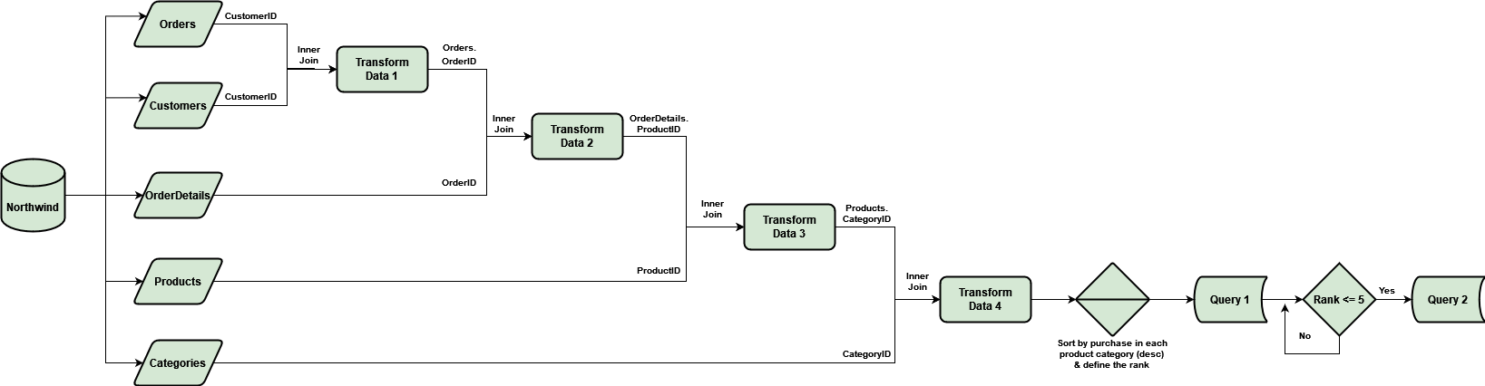

Slide 50
Output
Table
Product_Category | Company_Name | Purchase | Rank
Beverages | QUICK-Stop | 36216.43 | 1
Beverages | Hanari Carnes | 20084.15 | 2
Beverages | Rattlesnake Canyon Grocery | 19208.15 | 3
Beverages | Ernst Handel | 12709.30 | 4
Beverages | Great Lakes Food Market | 11694.38 | 5
Product_Category | Company_Name | Purchase | Rank
Dairy Products | Ernst Handel | 24496.46 | 1
Dairy Products | Save-a-lot Markets | 21107.10 | 2
Dairy Products | QUICK-Stop | 13800.85 | 3
Dairy Products | Frankenversand | 10552.10 | 4
Dairy Products | Hungry Owl All-Night Grocers | 9010.11 | 5
Product_Category | Company_Name | Purchase | Rank
Condiments | Ernst Handel | 14070.06 | 1
Condiments | QUICK-Stop | 9214.93 | 2
Condiments | Save-a-lot Markets | 7873.00 | 3
Condiments | White Clover Markets | 4174.13 | 4
Condiments | Folk och fä HB | 3651.50 | 5
Product_Category | Company_Name | Purchase | Rank
Grains/Cereals | Ernst Handel | 12737.70 | 1
Grains/Cereals | Save-a-lot Markets | 8298.10 | 2
Grains/Cereals | QUICK-Stop | 5310.90 | 3
Grains/Cereals | Rattlesnake Canyon Grocery | 4831.30 | 4
Grains/Cereals | Mère Paillarde | 4553.85 | 5
Product_Category | Company_Name | Purchase | Rank
Confections | QUICK-Stop | 18530.09 | 1
Confections | Ernst Handel | 12815.76 | 2
Confections | Save-a-lot Markets | 11900.07 | 3
Confections | Rattlesnake Canyon Grocery | 10947.21 | 4
Confections | Bottom-Dollar Markets | 5856.88 | 5

Slide 51
Output
Table
Product_Category | Company_Name | Purchase | Rank
Meat/Poultry | Save-a-lot Markets | 27659.18 | 1
Meat/Poultry | Hungry Owl All-Night Grocers | 20914.23 | 2
Meat/Poultry | QUICK-Stop | 9754.96 | 3
Meat/Poultry | Ernst Handel | 8325.56 | 4
Meat/Poultry | Richter Supermarkt | 6522.84 | 5
Product_Category | Company_Name | Purchase | Rank
Produce | Ernst Handel | 12469.67 | 1
Produce | QUICK-Stop | 8081.40 | 2
Produce | Folk och fä HB | 6464.00 | 3
Produce | Save-a-lot Markets | 3887.90 | 4
Produce | Bon app' | 3718.75 | 5
Product_Category | Company_Name | Purchase | Rank
Seafood | Save-a-lot Markets | 13604.60 | 1
Seafood | QUICK-Stop | 9367.74 | 2
Seafood | Ernst Handel | 7250.48 | 3
Seafood | Hungry Owl All-Night Grocers | 6899.18 | 4
Seafood | Bon app' | 5368.58 | 5

Slide 52
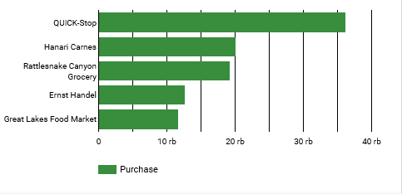
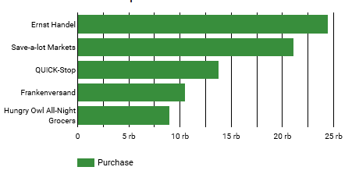
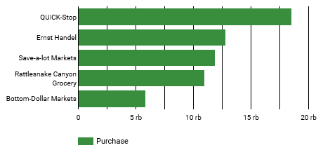
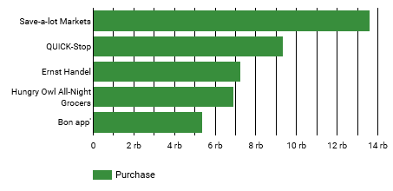
Top 5 Customers in Beverages Sales
Top 5 Customers in Dairy Products Sales
Top 5 Customers in Confections Sales
Top 5 Customers in Seafood Sales

Slide 53
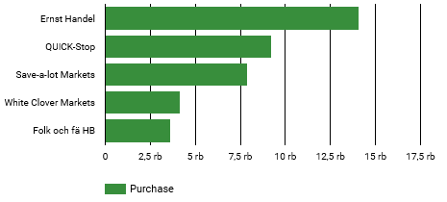
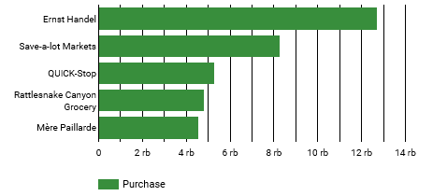
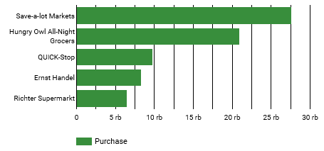
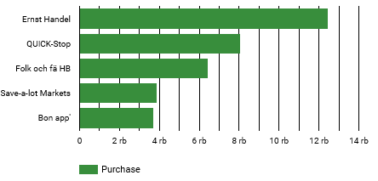
Top 5 Customers in Condiments Sales
Top 5 Customers in Grains / Cereals Sales
Top 5 Customers in Meat / Poultry Sales
Top 5 Customers in Product Sales

Slide 54
Analysis :
In every product category, Quick Stop & Ernst Handel is always in the top 5 consumers with high purchase rates. The same thing happened to the Save a Lot Market, but only on the beverages product category, the Save a Lot Market was not included in the top 5 customer category

Slide 55
Thanks!

